Slide 1
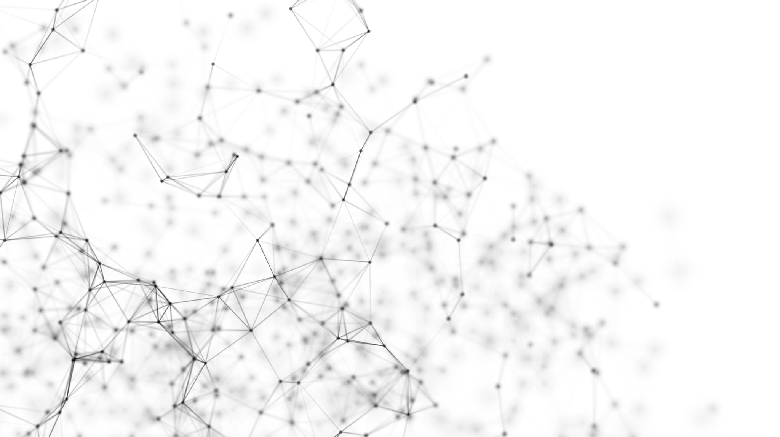

Face recognition adversarial ATTACKS
Defend against adversarial attacks in face recognition (FR) models
Shelly Francis
GIL KAPEL
24 / 01 / 2023

Slide 2
Introduction
Face recognition is a domain with many uses in real-world applications – ranging from photo tagging to automated border control (ABC).
Today’s models have high accuracy
Vulnerable to adversarial attacks.
An attacker can intentionally design features that would confuse the network and even impersonate to someone else.
We tested some countermeasures against these attacks

Slide 3
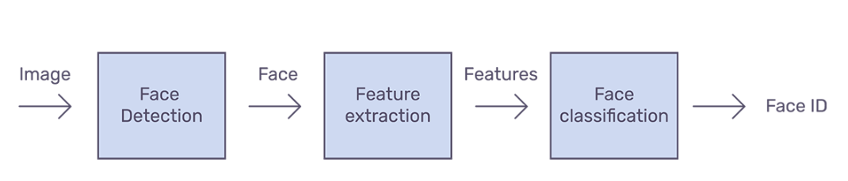
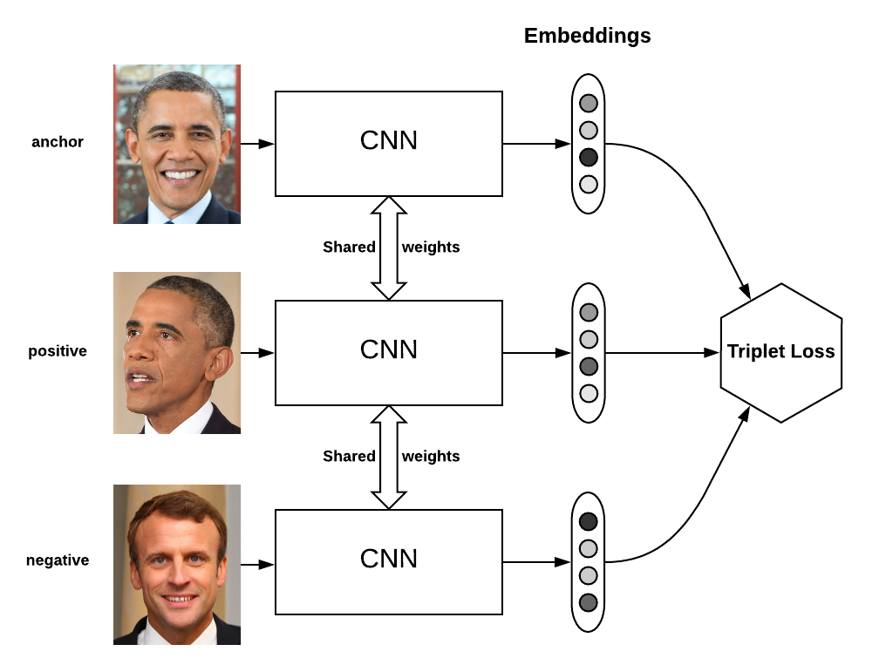
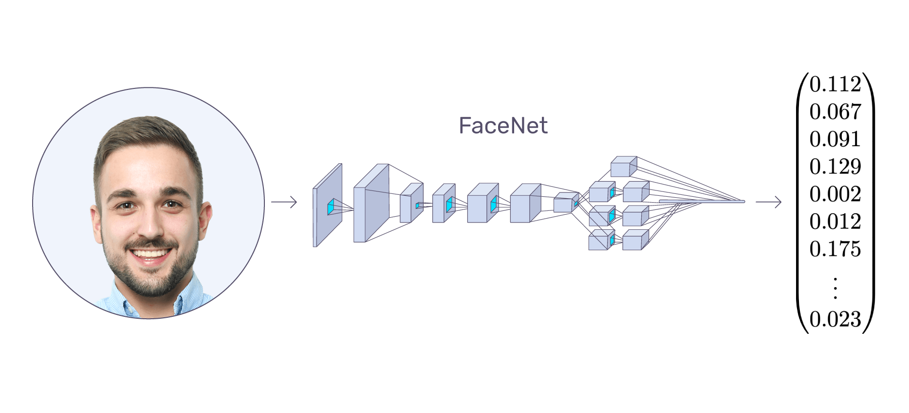
Face recognition
Face Net
Classifier
Triplet Loss
Deep neural network used for extracting features from an image of a person’s face
Last layer of the Face Net is a SoftMax layer with width of identities number

Slide 4
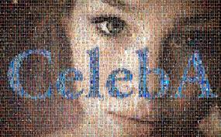
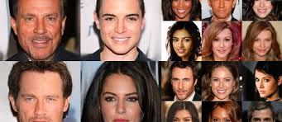
THE DATASET: subset of Celeba-hq
CelebA is an open-source dataset that contains images of celebrities with different attributes and classes
The CelebA-HQ dataset is a high-quality version of CelebA that consists of 30,000 images at 256x256 resolution
We used a subset of CelebA-HQ with more then 300 identities and 5,000 images (16 images pre identity in avg)

Slide 5
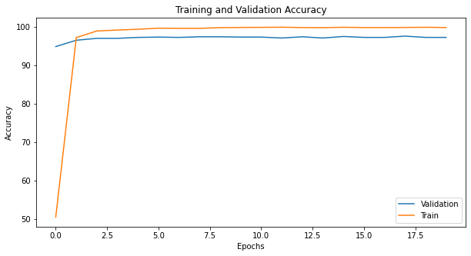
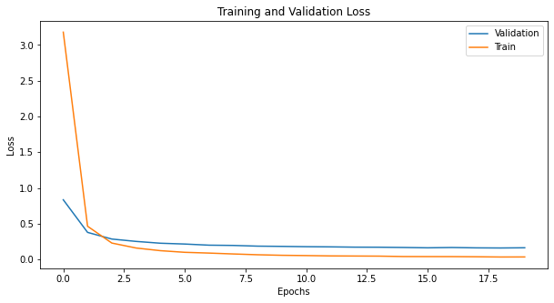

Building our face recognition model
We Fine-tuned a face-net model based on “res-net”.
Only the last layer was changed and required gradients, the training lasted 20 epochs.

Slide 6
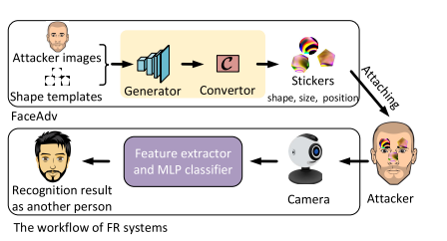
The problem
The behavior of machine learning systems can be manipulated, with potentially devastating consequences
Face recognition systems are vulnerable to different types of augmentations
Augmentations
Age
Hair color / style
accessories
Eye-glasses
Noise
Color jitter
Manual patches

Slide 7

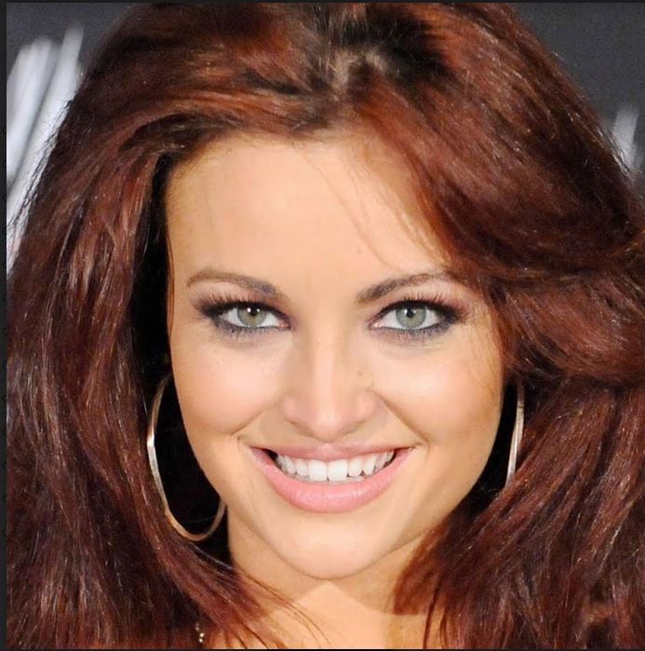
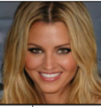
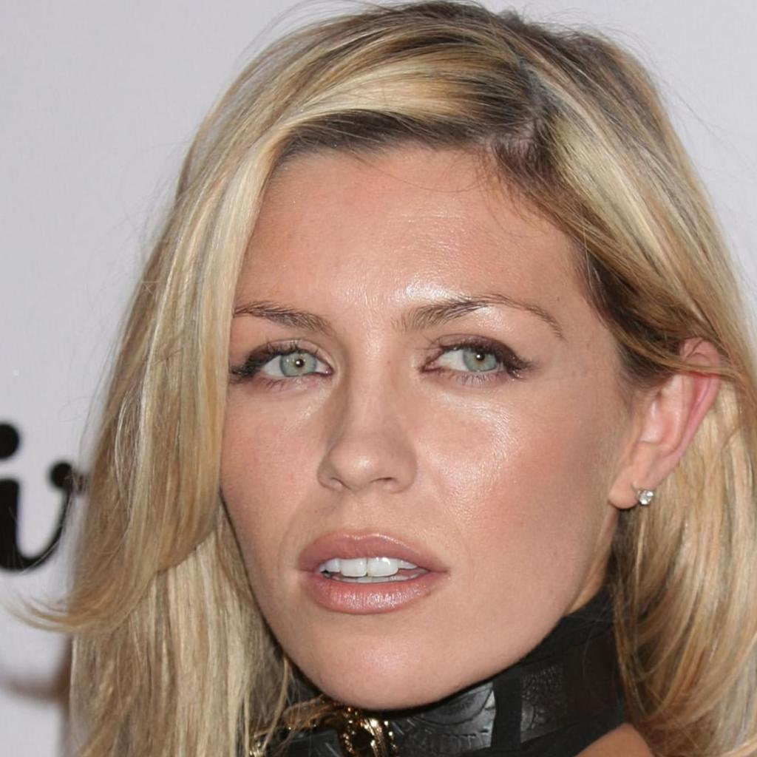
The problem
Let's say Alex Lehnert travels to Sweden and don’t want to register as herself
She can search for a person with different hair color and style, change her look and the FR system would recognize her as someone else!

Slide 8
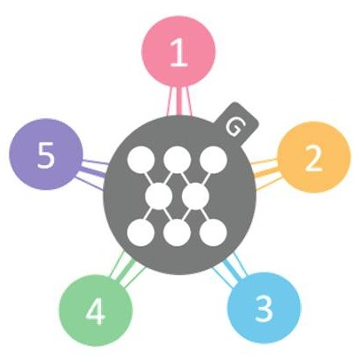
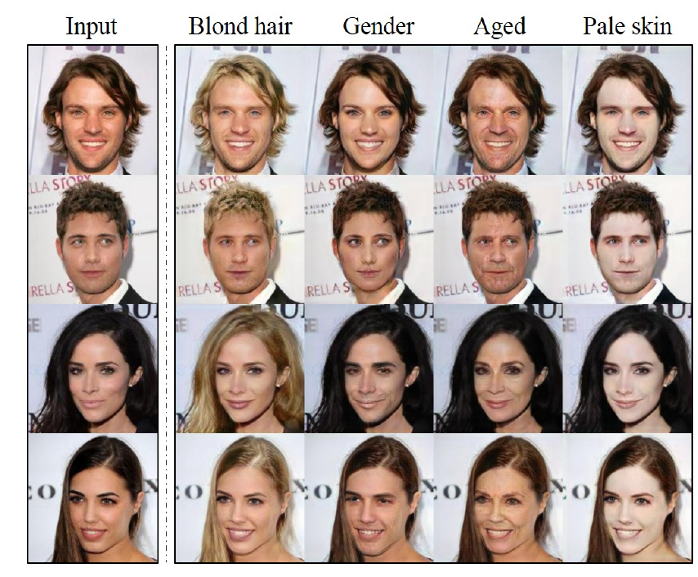
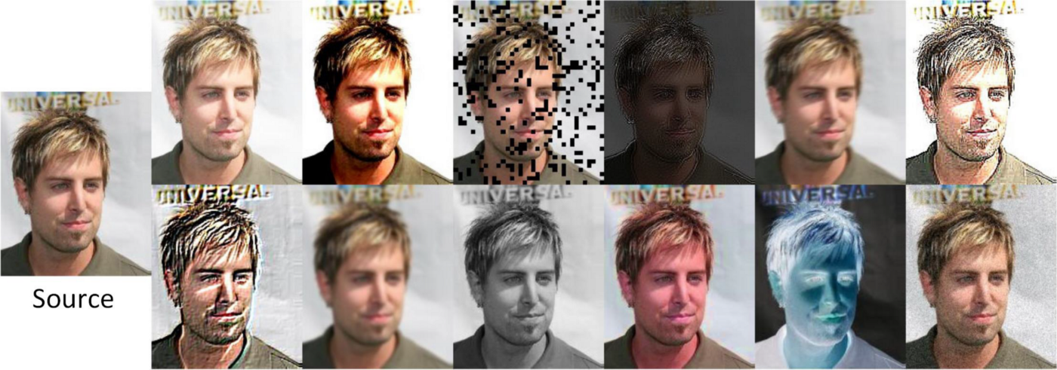
Our solution
Fine-Tuned Face-Net with augmented images
Option 1:
Star GAN: Image-To-Image translation for generating new and different styling options to each identity
Option 2:
Generating new data for each identity with color, noise and blur augmentation
We checked the meaning of re-training Face-net with the generated data from scratch and got similar results!

Slide 9
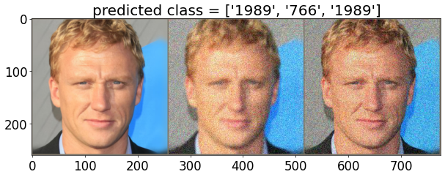
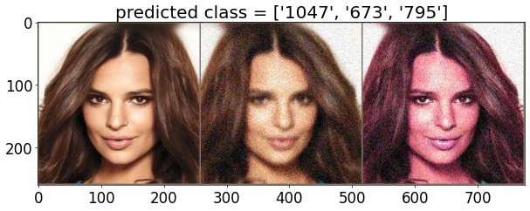
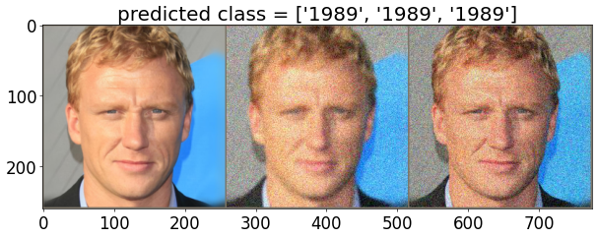
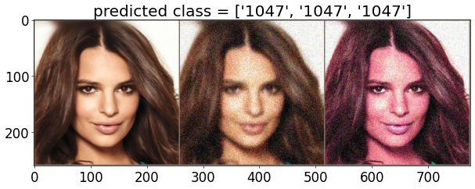
Classic Image augmentations
Random Gaussian noise + Blur
Random Gaussian noise + Color jitter
Random Gaussian noise + Blur
Random Gaussian noise + Color jitter
Original
Original
Accuracy: 74%

Slide 10

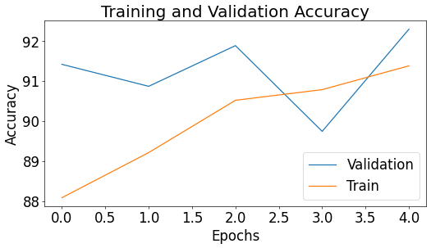
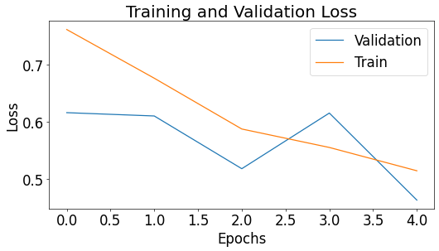
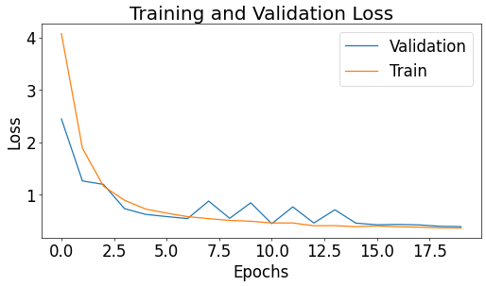
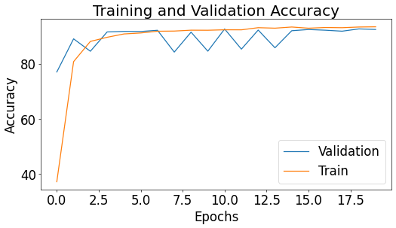

Classic Image augmentations
Fine-Tune on augmentation with 5 epochs
Train the model from scratch with 20 epochs

Slide 11
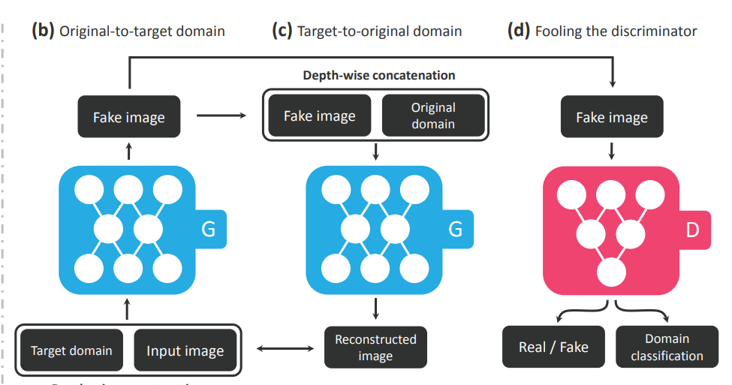
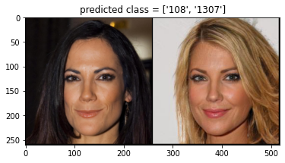
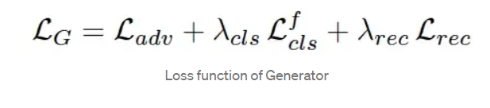
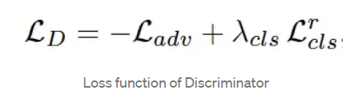
STAR-GAN - structure
Translate images from one domain to the other
Domain
Set of images sharing the same attribute value
Real image
Classify as target domain
Reconstructed image
Real / Fake
Classify the domain
Notes:
The discriminator has two tasks – to distinguish if the input is real or fake and to classify correctly the target domain – what we want to change
The generator has three tasks – generate an image that looks real, that looks like it belongs to the target domain and to be cycle consistency .
G takes in as input both the image and target domain label and generates a fake image
G tries to reconstruct the original image from the fake image given the original domain label.
Here, Discriminator not only tells us the fakeness but also classifies an image to its corresponding domain, so that G tries to generate images that are indistinguishable from real images and are classifiable as target domain by D. i.e. G will ultimately learn to generate realistic images corresponding to the given target domain. (d)
Objectives of the Discriminator
Here, the Discriminator has two things to do,
It should be able to identify whether an image is fake or not.
With the help of an auxiliary classifier on top of D, Discriminator can also predict the domain of the image given as input to D.
What is the use of the auxiliary classifier?
With the auxiliary classifier, D learns the mapping of original image and its corresponding domain form the dataset. When G generates a new image conditioned on a target domain c (say blonde hair) , D can predict the generated image’s domain so G will generate new images till D predict it as target domain c (blonde hair).
Objectives of the Generator
The Generator has three purposes —
Images generated are realistic.
Generated images are classifiable as target domain by D.
G tries to reconstruct the original image from the fake image given the original domain label. We use a single generator twice, first to translate an original image into an image in the target domain and then to reconstruct the original image from the translated image.

Slide 12
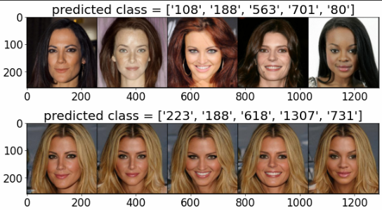
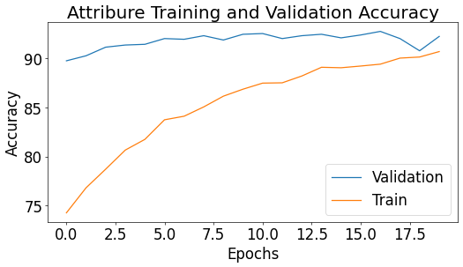
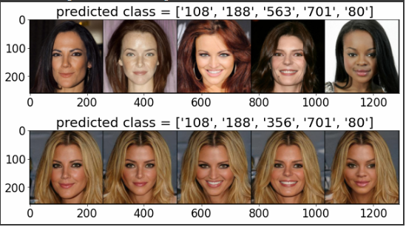
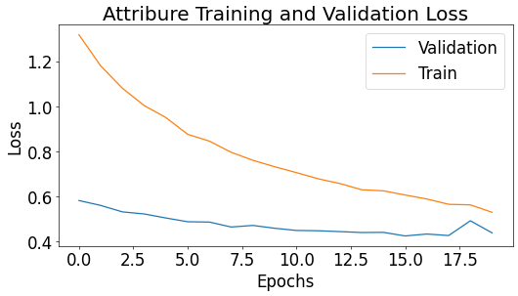
RESULTS
The attack BEFORE fine-tuning
Training graphs
The attack AFTER fine-tuning

Slide 13
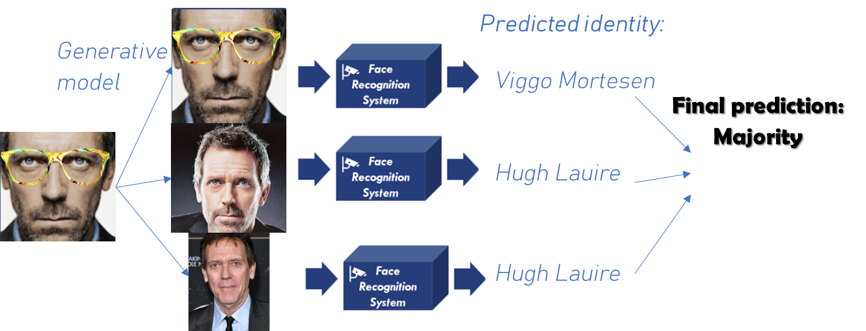
Future work
Train the network on a large verity of augmentations
Run more tests with a range of seed numbers for more reliable results.
Add dataset’s information of attributes for each identity to StarGAN in order to make a more reliable attributes
Train the model on other domains – such as eyeglasses, beard, face expressions etc.
Build an inference algorithm that can distinguish whether the system is under adversarial attack, without specifying who is the real identity

Slide 14
Questions?
Defend against adversarial attacks in face recognition (FR) models
Shelly Francis
GIL KAPEL
24 / 01 / 2023

